Slide 1
Udacity Self Driving car engineer Nanodegree Program Chapter1- Computer Vision
Udacity self driving car Engineer nanodegree program Chapter1-Computer Vision
Document compiled by: Poluri Nikhil Koundinya
THE MACHINE LEARNING WORKFLOW
Document prepared by - Poluri Nikhil Koundinya
INTRODUCTION TO DL USING CV

Slide 2
2- The ML Workflow

Slide 3
What is ML?
ML is a type of AI where the computer is learning how to extract information from data. To train an ML algorithm, we have to feed it with example data.
In the lesson, we are going to learn how to think about Machine Learning problems. Machine Learning (ML) is not only about cool math and modeling but also about choosing setting the problem, identifying the client needs and the long term goals. This lesson is going to be organized as follow:
We will practice framing Machine Learning problems by identifying the key stakeholders and choosing the correct metrics.
Because ML is about data, we will discuss the different challenges linked to data.
We will also tackle how to organize your dataset when solving a ML problem to be confident that you created a model that will perform well on new data.
Finally, we will see how you can leverage different tools to pinpoint your model's limitations.

Slide 4
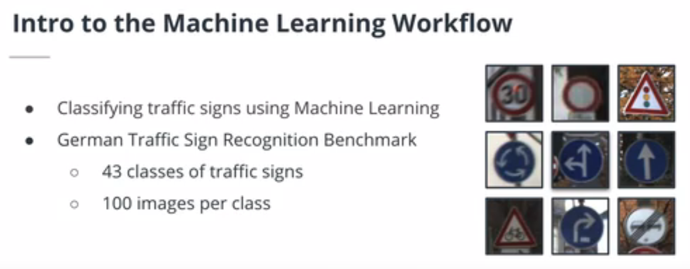

Slide 5
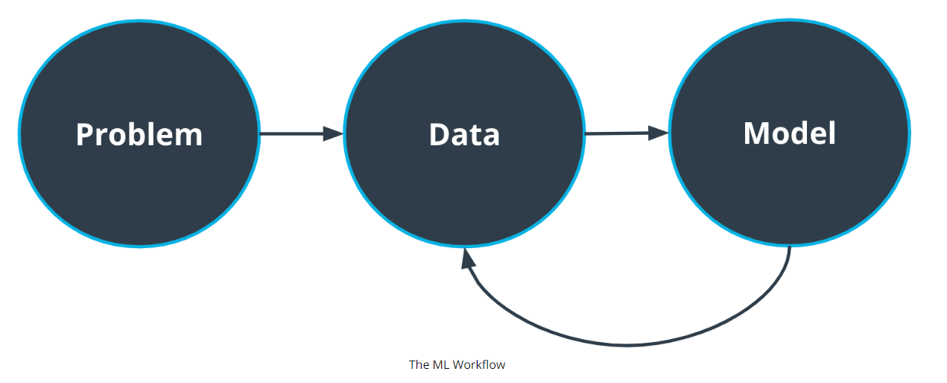
The Big Picture
1-Which approach is best for this problem?
2-What are the constraints? Eg- are there limitations because of the hardware?
Then we have feedback loop between the model and data. We can decide if we require more data for the model.
1- Frame the problem.
2- What are we trying to achieve here? 3- Why?
4- Who cares about this problem?
5- Do we even need ML?
want to solve?
1- How much data do we need?.
2-Is data easy to obtain? 3- How much processing is required?
Once our dataset is ready, we can focus on the model

Slide 6
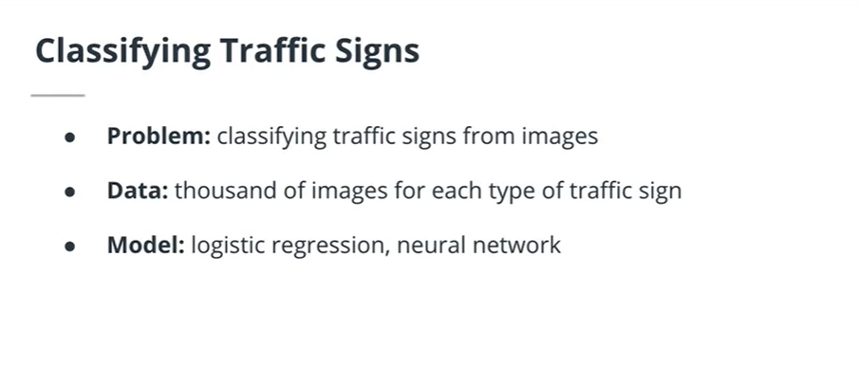
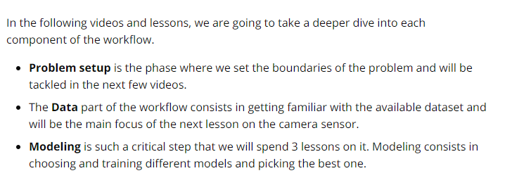
Example: For traffic sign classification problem

Slide 7
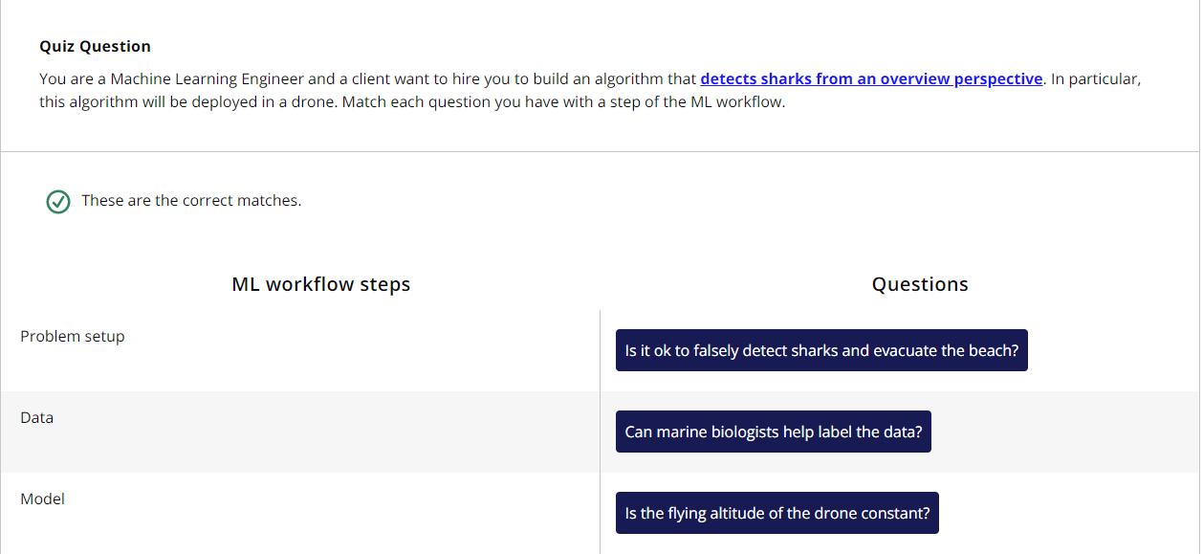

Slide 8
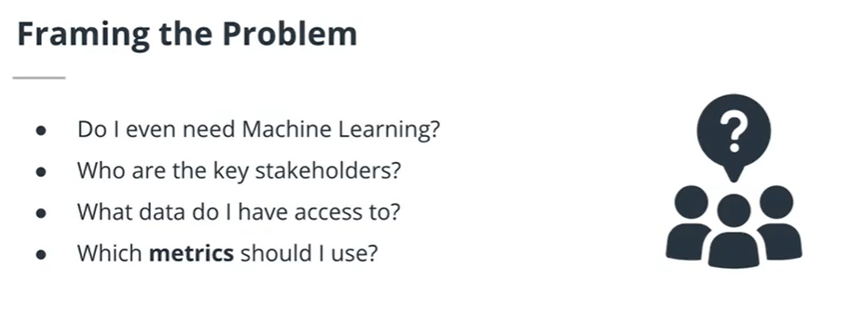
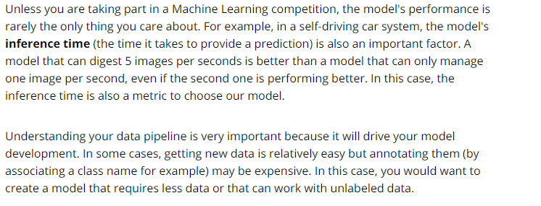
Framing the problem

Slide 9
Unless you are taking part in a Machine Learning competition, the model's performance is rarely the only thing you care about. For example, in a self-driving car system, the model's inference time (the time it takes to provide a prediction) is also an important factor. A model that can digest 5 images per seconds is better than a model that can only manage one image per second, even if the second one is performing better. In this case, the inference time is also a metric to choose our model.
Understanding your data pipeline is very important because it will drive your model development. In some cases, getting new data is relatively easy but annotating them (by associating a class name for example) may be expensive. In this case, you would want to create a model that requires less data or that can work with unlabeled data.

Slide 10
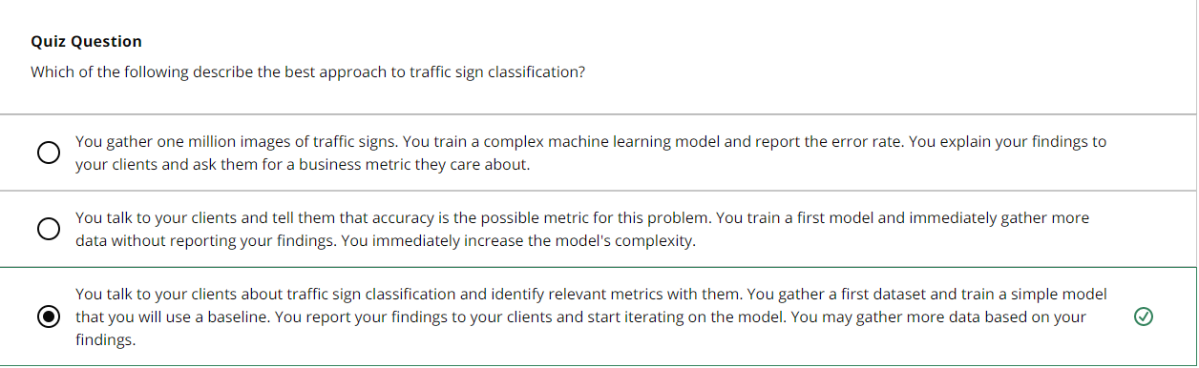
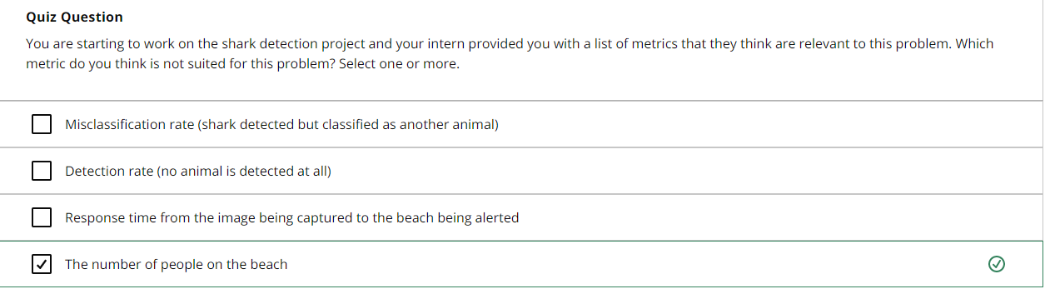

Slide 11
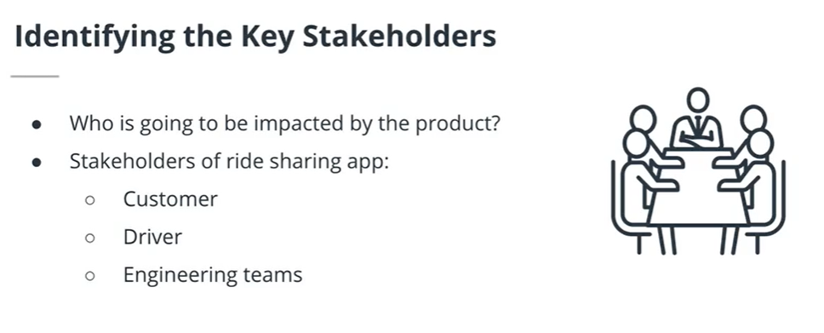
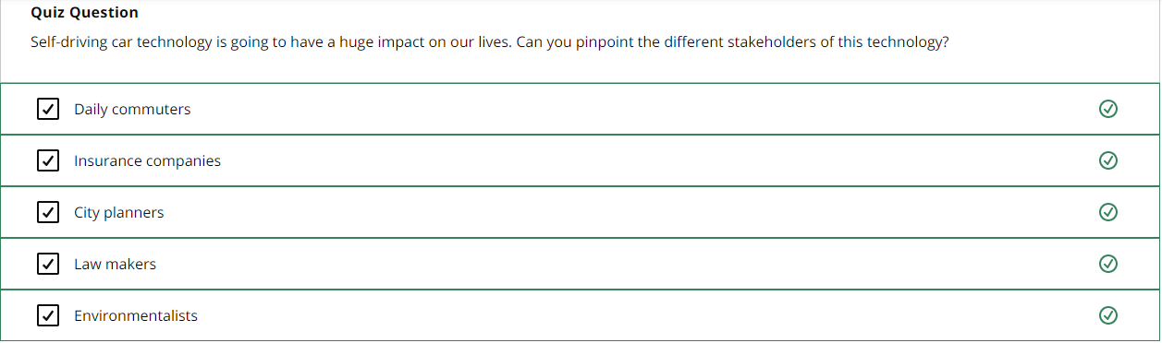

Slide 12
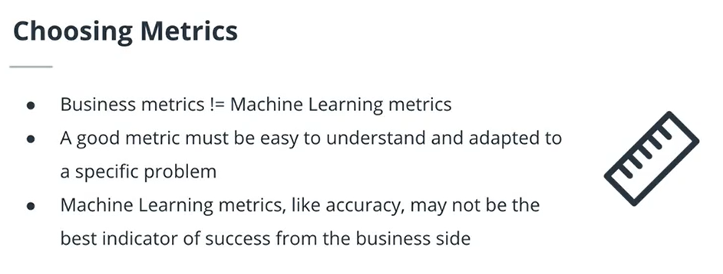
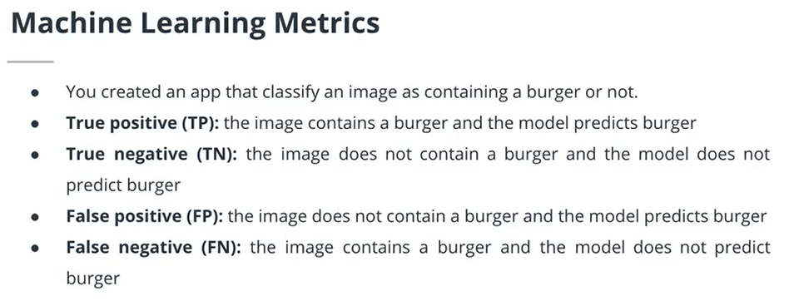

Slide 13
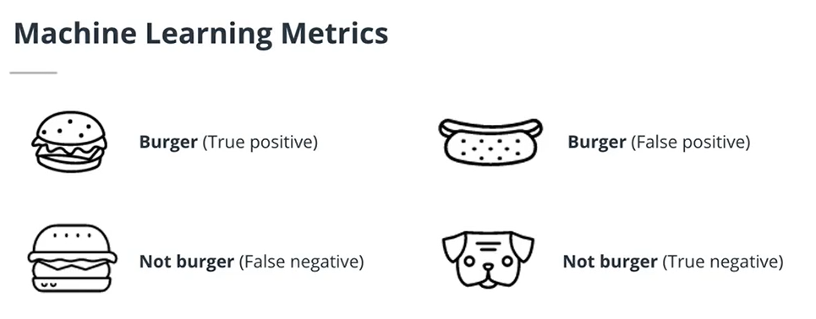
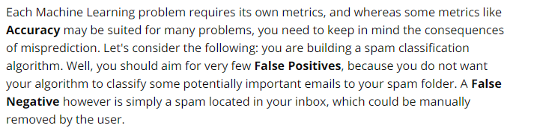
The image has a burger and algorithm detected a burger
The image has a hot- dog but the algorithm detected a burger
The image has a burger and algorithm classifies it as Not burger
The image has a dog and the algorithm does not classify it as burger

Slide 14
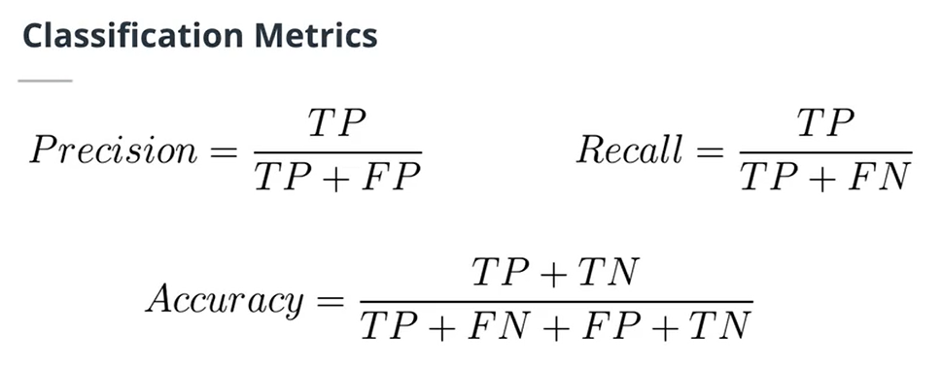
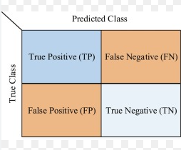
CONFUSION MATRIX

Slide 15
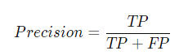
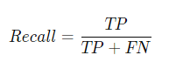
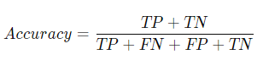
Precision: Of the elements classified as a particular class, how many did we get right? For example, we classified 6 images as containing burgers and only 5 of them actually contain a burger. The precision is 5/6.
Recall: The number of images classified correctly divided by the total number of images. For example, we have 40 images of burgers and we classified 15 of them correctly. The recall is 15/40.
We use the same definitions of precision and recall for object detection but instead we consider the number of instances of an object per image.
Accuracy: (Only for classification problems) The number of correctly classified images over the total number of images.

Slide 16
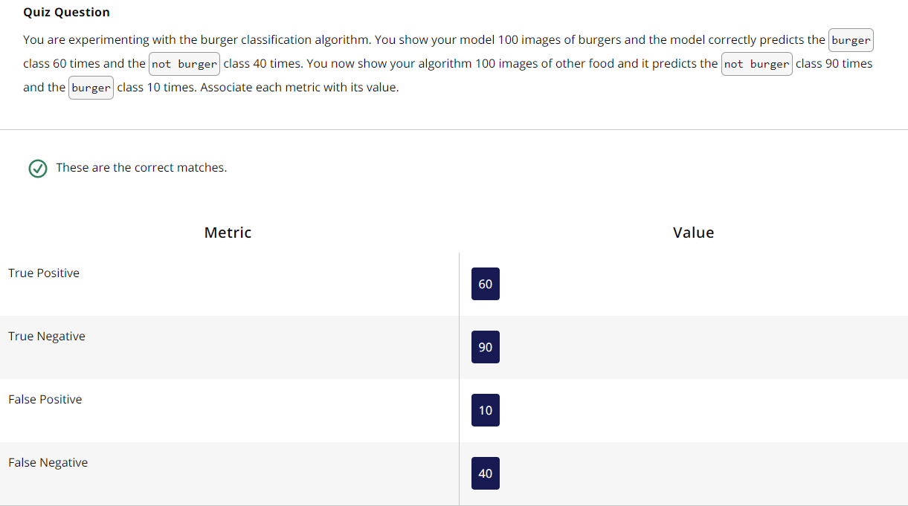

Slide 17
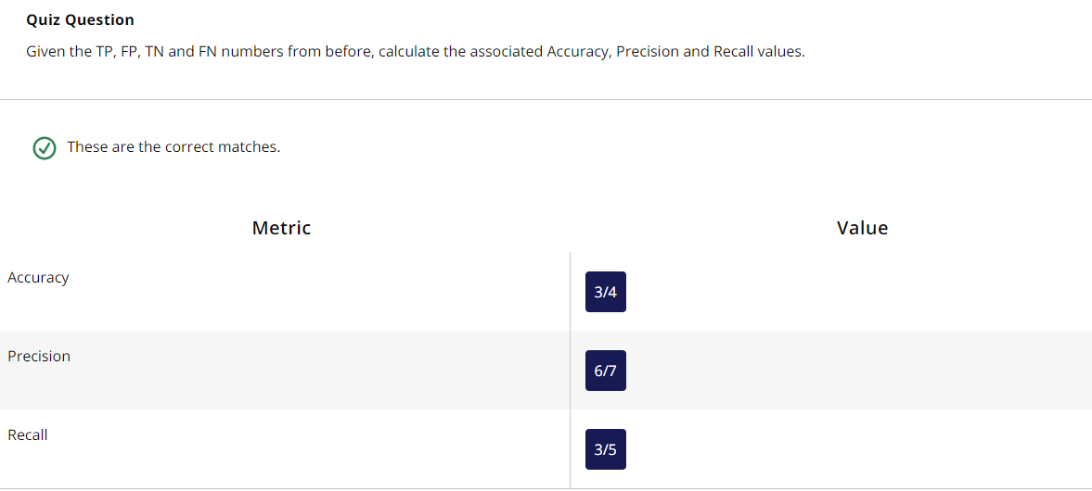

Slide 18
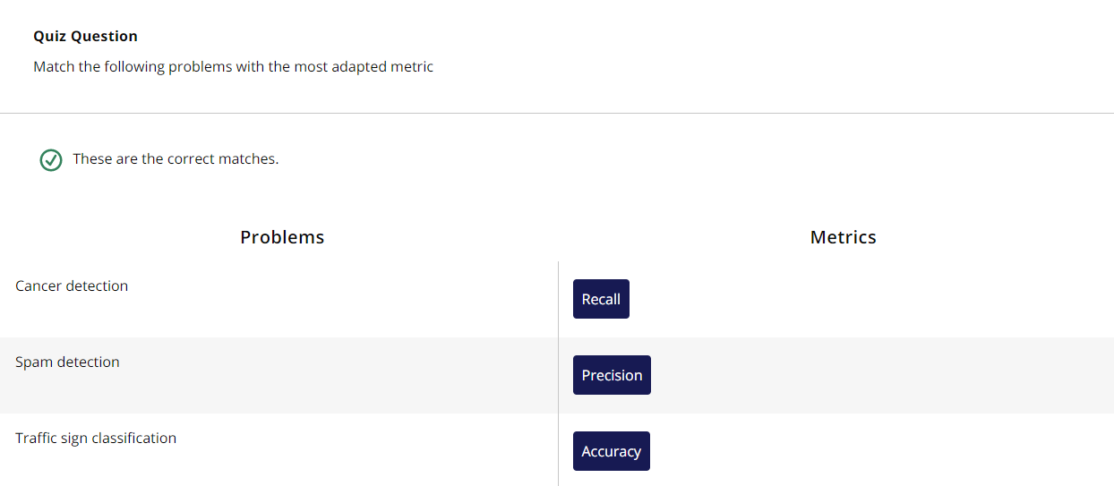

Slide 19
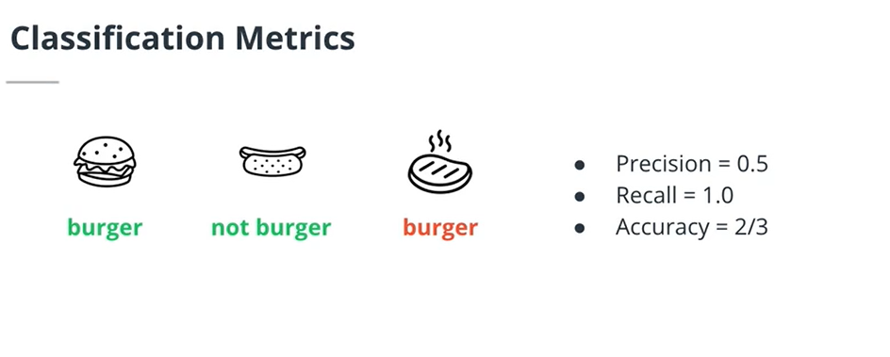
Precision: Of the elements classified as a particular class, how many did we get right? For example, we classified 6 images as containing burgers and only 5 of them actually contain a burger. The precision is 5/6.
Recall: The number of images classified correctly divided by the total number of images. For example, we have 40 images of burgers and we classified 15 of them correctly. The recall is 15/40.
Accuracy: (Only for classification problems) The number of correctly classified images over the total number of images.
Image has a “burger” and burger is predicted
Image has a hot dog and “Not burger” is predicted
Image has a stake and a “burger” is predicted
Therefore we have one TP, one TN and one FP. So, we can calculate using Precision, recall and accuracy using the formulas in the previous page.

Slide 20
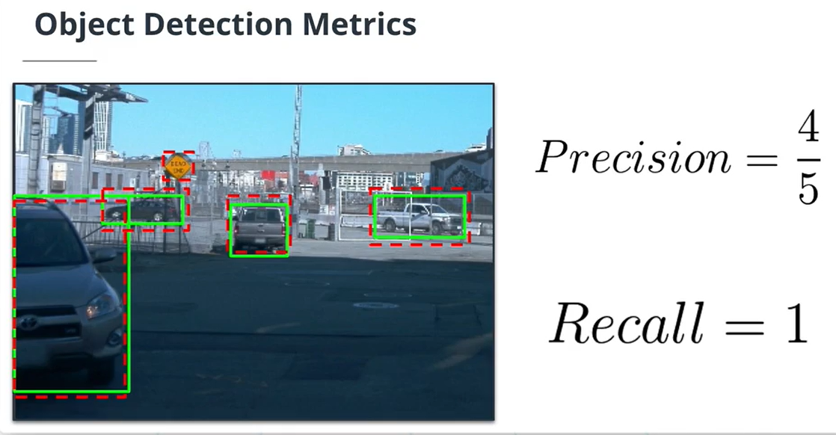
Green Box- Ground Truth
Red Box- Model’s Prediction
True Positives in the case of Object detection is found out using the concept of IOU (Intersection over Union)

Slide 21
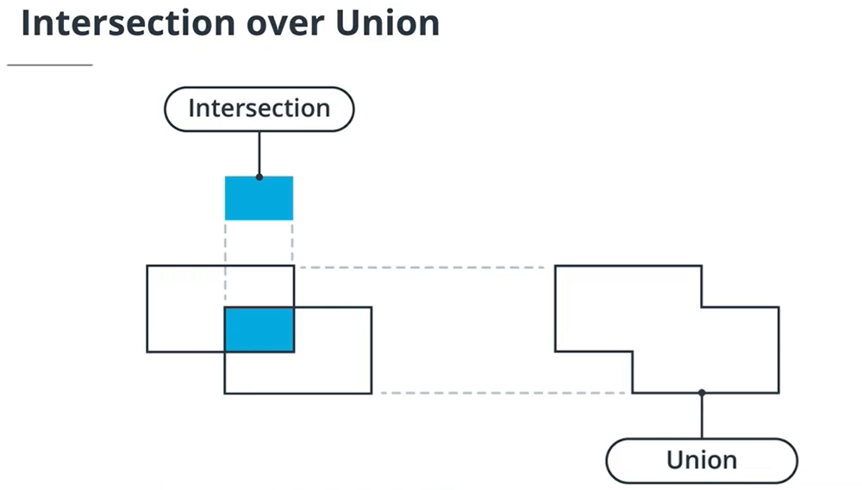

Slide 22
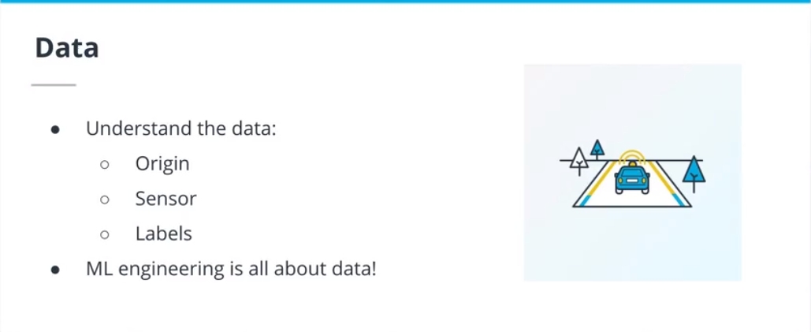
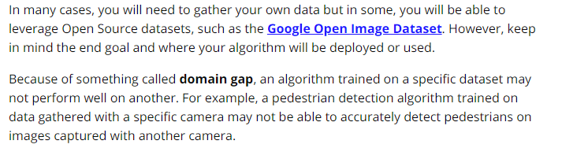
Data Acquisition and Visualization
In many cases, you will need to gather your own data but in some, you will be able to leverage Open Source datasets, such as the Google Open Image Dataset(opens in a new tab). However, keep in mind the end goal and where your algorithm will be deployed or used.
Because of something called domain gap, an algorithm trained on a specific dataset may not perform well on another. For example, a pedestrian detection algorithm trained on data gathered with a specific camera may not be able to accurately detect pedestrians on images captured with another camera.

Slide 23
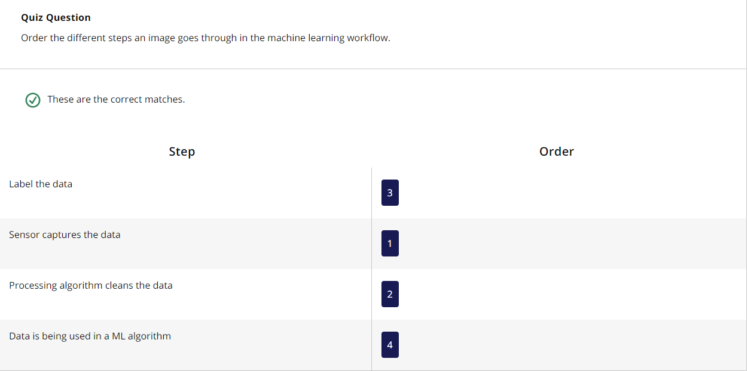
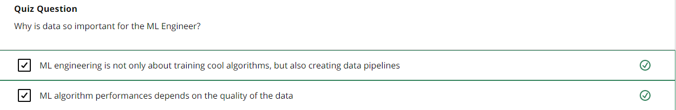

Slide 24
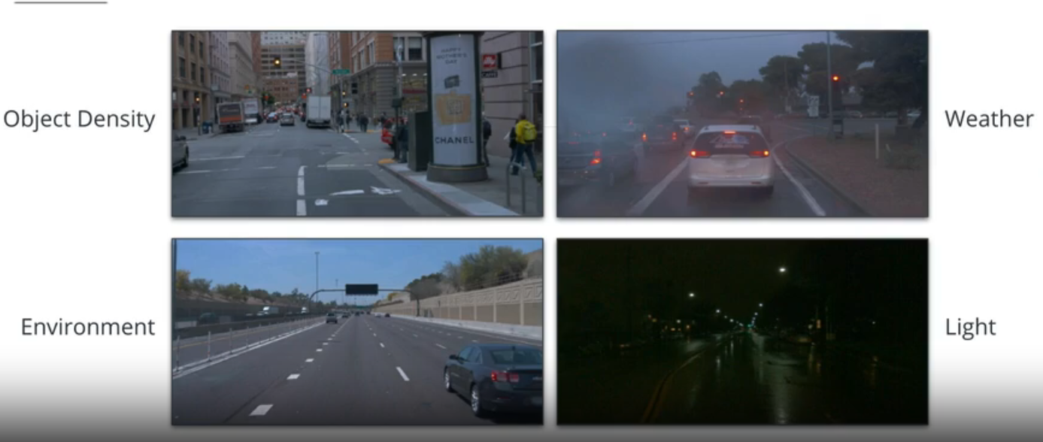
Exploratory Data Analysis
Machine Learning algorithms may be very sensitive to domain shift. This domain shift can happen at different levels:
weather / light conditions: for example, an algorithm trained only on sunny images is not going to perform well when shown rainy or night-time data.
sensor: a sensor change or different processing methods will create a domain shift.
environment: an algorithm trained on low intensity traffic data will not perform well on high intensity traffic data for example.
An extensive Exploratory Data Analysis (EDA) is critical to the success of any ML project. Why? Because during this phase, the ML engineer gets acquainted with the dataset and discovers any potential challenges with the data. The EDA is such an important part of the project that ML engineers spend a few days on it alone. For a vision problem, it requires looking at 1,000s of images in your dataset!

Slide 25
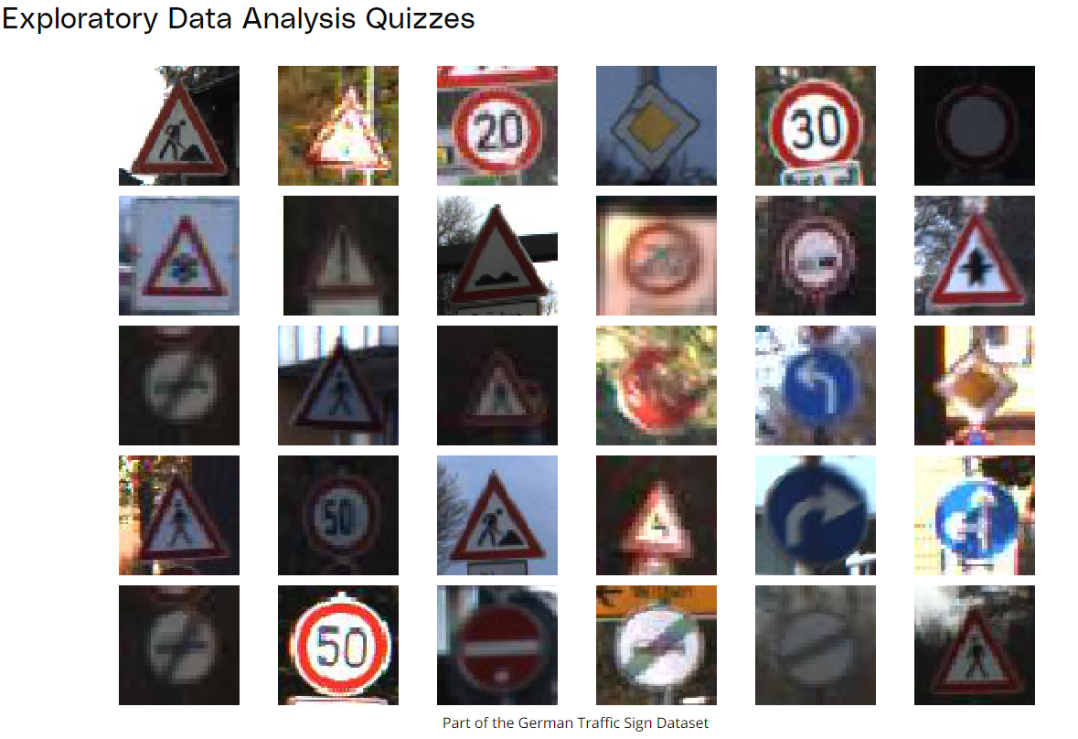

Slide 26
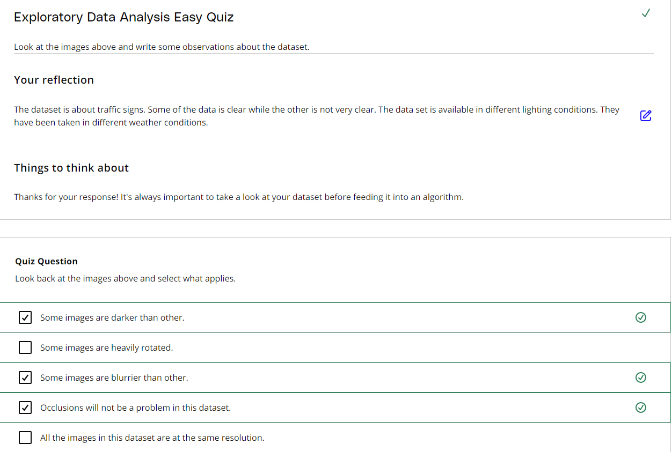

Slide 27
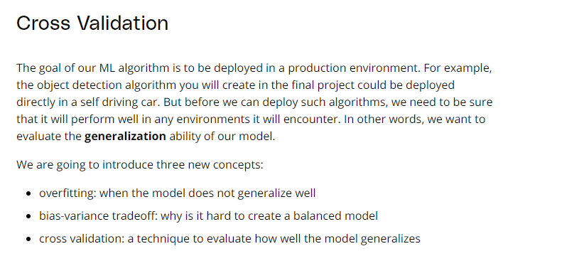
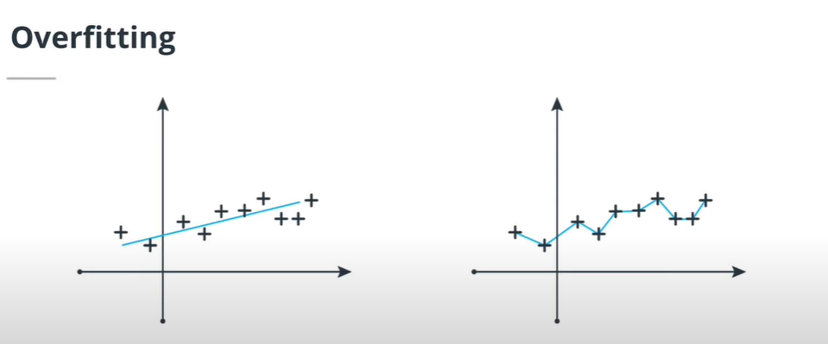
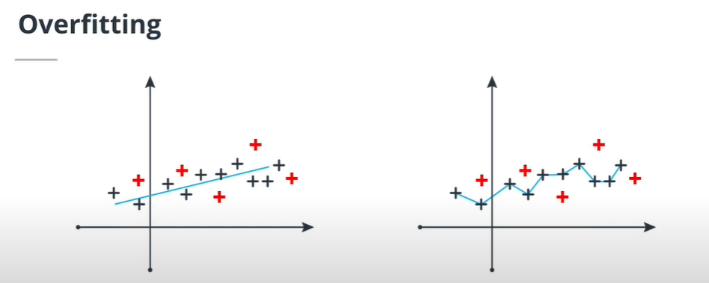
For new data polynomial regression does not generalize well
We try to fit a linear regression model
We try to fit a Polynomial regression model
For new data linear regression generalizes well

Slide 28
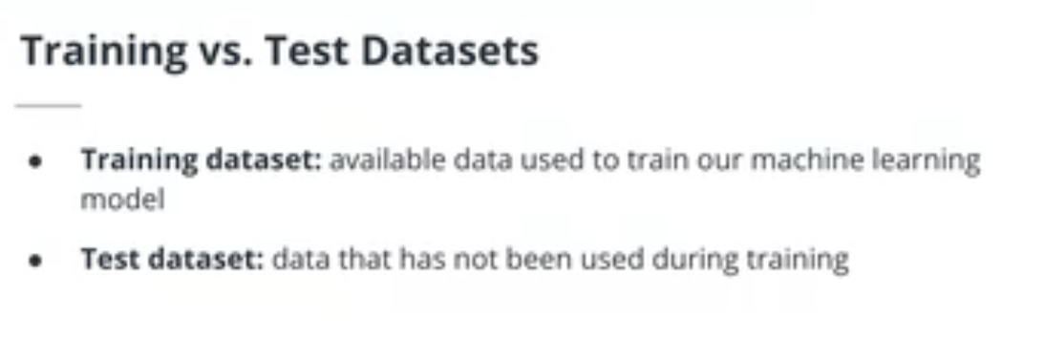

Slide 29
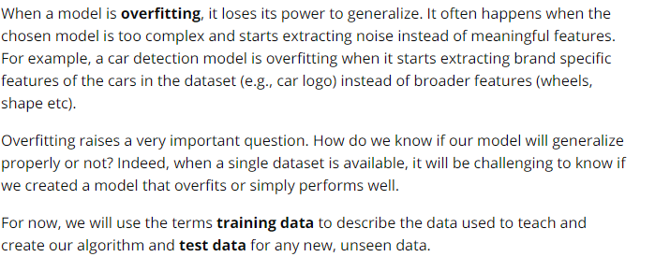
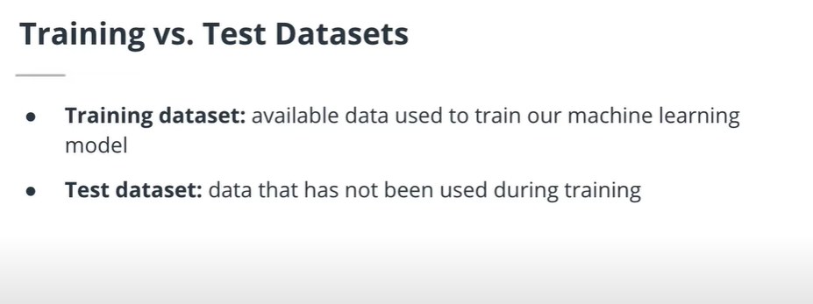
The challenge in ML lies in creating a model that performs well on available data without overfitting

Slide 30
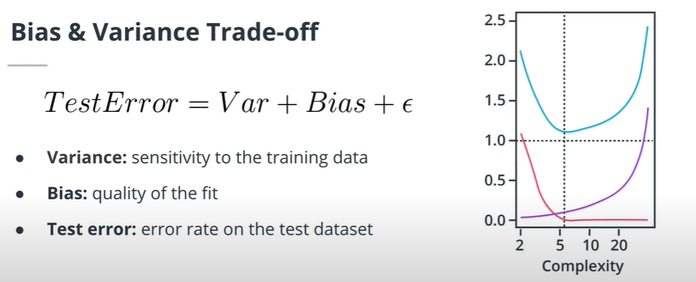
We would like our model to generalize well to unseen datasets during training. We are going to analyze the performances of our algorithms on test data sets, In particular, we are interested in test error which is the error rate of the model in test dataset.
1- As the complexity (Number of parameters) of the model increases, the bias (In red) decreases. However, the variance (In purple) increases with increase in complexity. It loses its ability to generalize.
2- If we sum both terms, we get the test error in blue (On the top). The blue curve shows existence of an optimal complexity where the test error is minimized ( around (1.2,5).
3- this is called bias- variance tradeoff. You want your model to be complex enough for low bias. But not too complex so that you can still generalize to unseen data
To minimize the test error, we have to minimize both bias and Variance. We need to minimize both bias and variance, which means our model should work well both on training data and test data. However, by minimizing the bias, we tend to increase the variance.

Slide 31
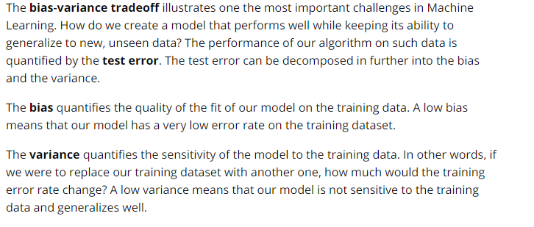

Slide 32
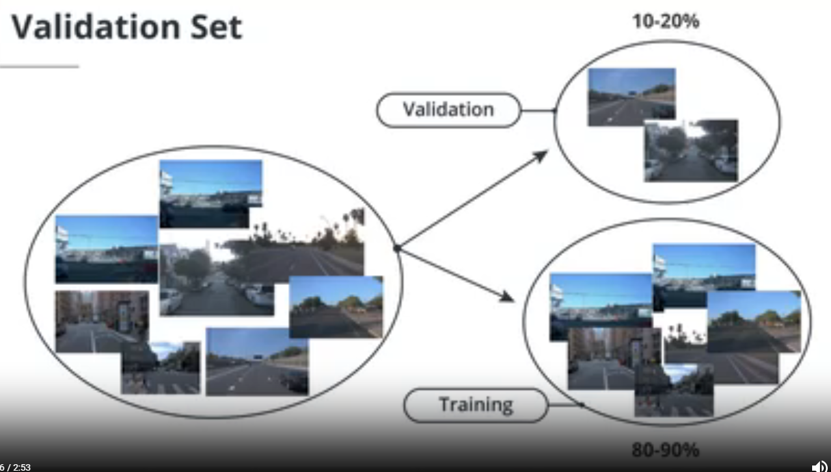

Slide 33
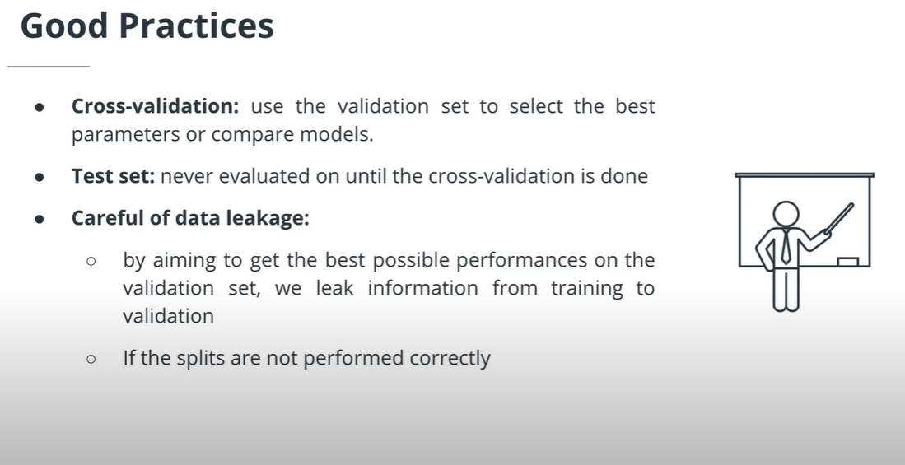
(80%-90%)
Training data
So, we train our model using the training set and check the model performance with the cross validation set. If everything is satisfactory, then we test it using the testing set.
Total Data
Testing data
(20%-10%)
This is how it is done generally, but we can also have a validation. This will help in the following way:
(70%)
Training data
Total Data
(15%)
Testing data
Only used once our model has been chosen
(15%)
Cross Validation data
This is done to evaluate our model and choose the best parameters for the model to minimize the error

Slide 34
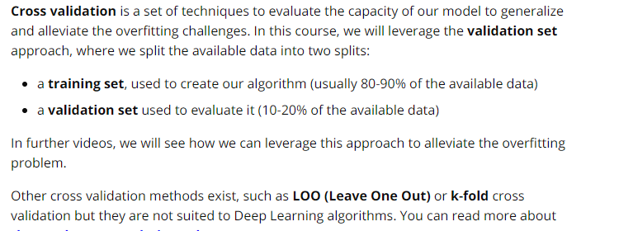

Slide 35
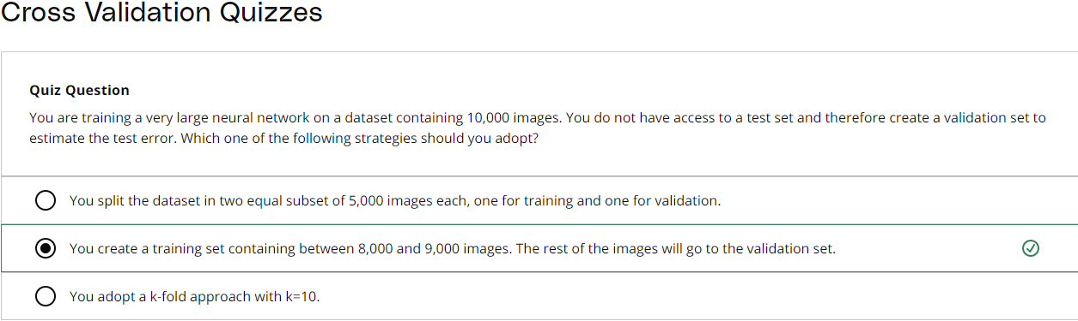
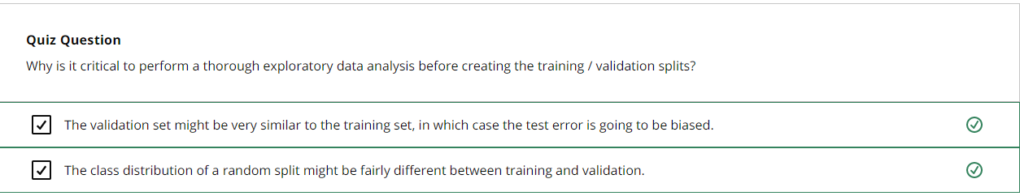

Slide 36
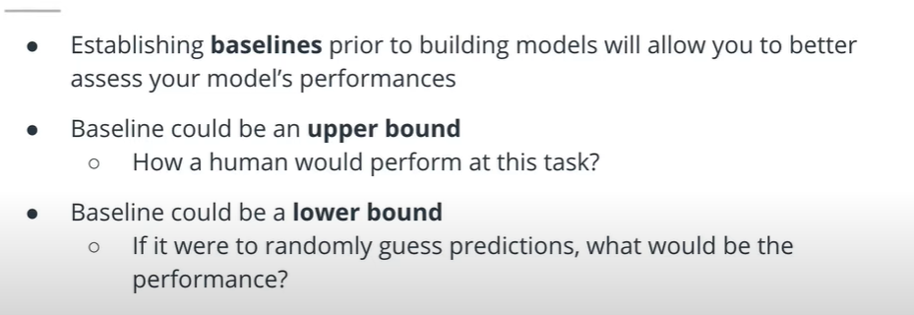
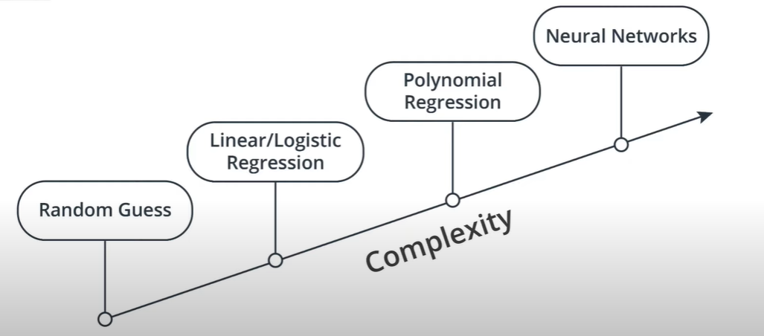
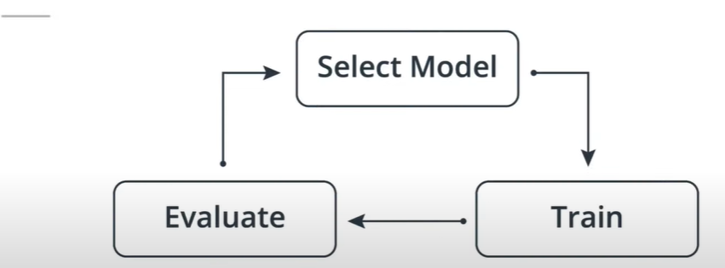
MODEL SELECTION AND STEPS INVOLVED IN MODEL SELECTION
STEPS 1: Establish Baselines
STEPS 2: Start building different models. Start with simple model and then iterate to select the best model
STEPS 3: How to iterate

Slide 37
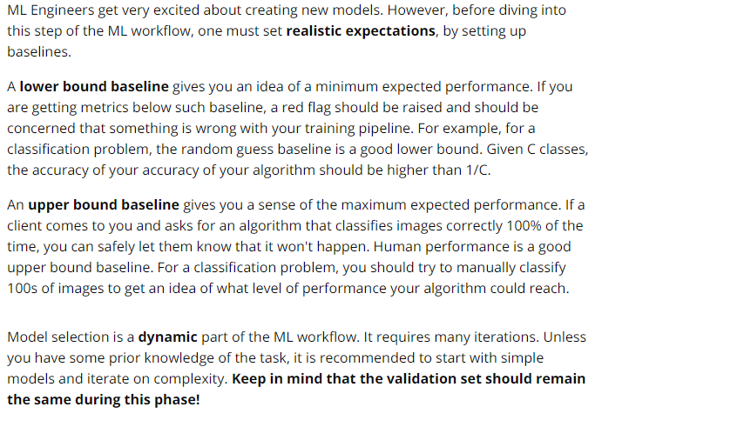

Slide 38



Slide 39



We have built a car detection model. Let us see how it works. The model detects some cars correctly, but not all of them.
1- In the left figure, Cars in the foggy region are not detected correctly. So, the model should be trained with foggy data.
2- In the figure on the right, smaller cars are not detected. So, we should see if the model can predict smaller cars by training it. If not, we should change the model.

Slide 40


Slide 41



Slide 42

The Machine Learning workflow is organized as follow:
Frame the problem: understand the stakes, and define relevant metrics.
Understand the data: perform an Exploratory Data Analysis, and extract patterns from the dataset.
Iterate on the model: create a validation set, set up baselines, and iterate on models from simpler to more complex.
A model is as good as its data

Slide 43


Slide 44
THE END

